Slide 1
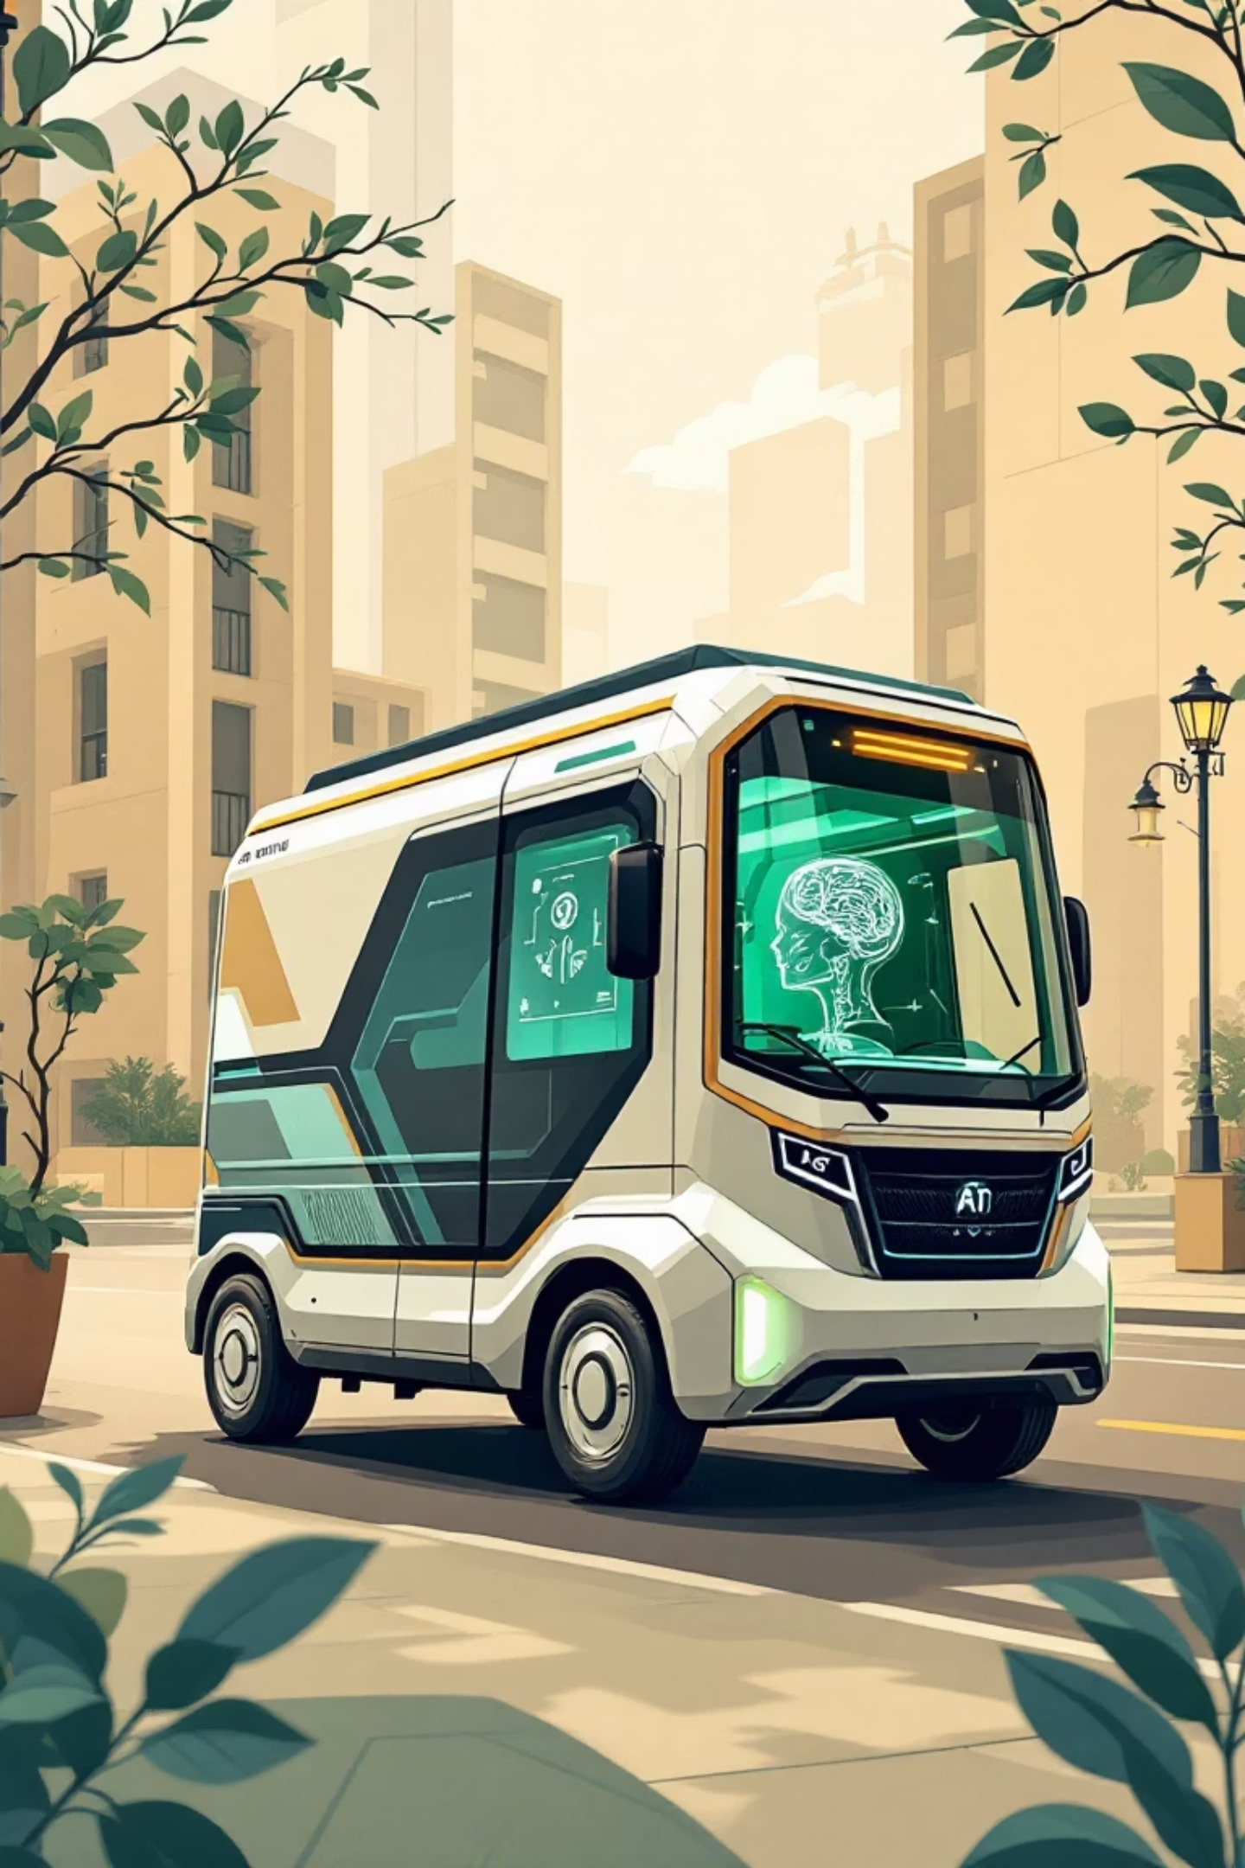
TrackMile: AI-Powered Smart Delivery & Logistics System
Submitted By: Tejas Thakor
Date: 29th December 2025

Slide 2

Abstract: Streamlining Last-Mile Delivery
Problem Solved
Key Integrations
Addresses delayed updates, lack of real-time visibility, and inefficient driver management in traditional delivery systems.
Real-Time GPS Tracking, Automated Driver Assignment, and AI-Driven Performance Analytics.
Unique Feature
Generative AI (Llama 3 via Groq) analyzes driver history for automatic performance reviews.

Slide 3





Introduction: Addressing Logistics Challenges
Lack of Visibility
Admins cannot see drivers in real-time.
Manual Assignment
Slow and error-prone order assignment.
Communication Gaps
Drivers struggle to update status instantly.
No Performance Metrics
Difficulty evaluating driver performance.

Slide 4


TrackMile's Proposed Solution
Admin Dashboard
Driver Console
For fleet managers to create orders, assign drivers, and view live locations on a map.
A mobile-friendly interface for drivers to accept jobs, navigate via checkpoints, and mark deliveries as complete.

Slide 5
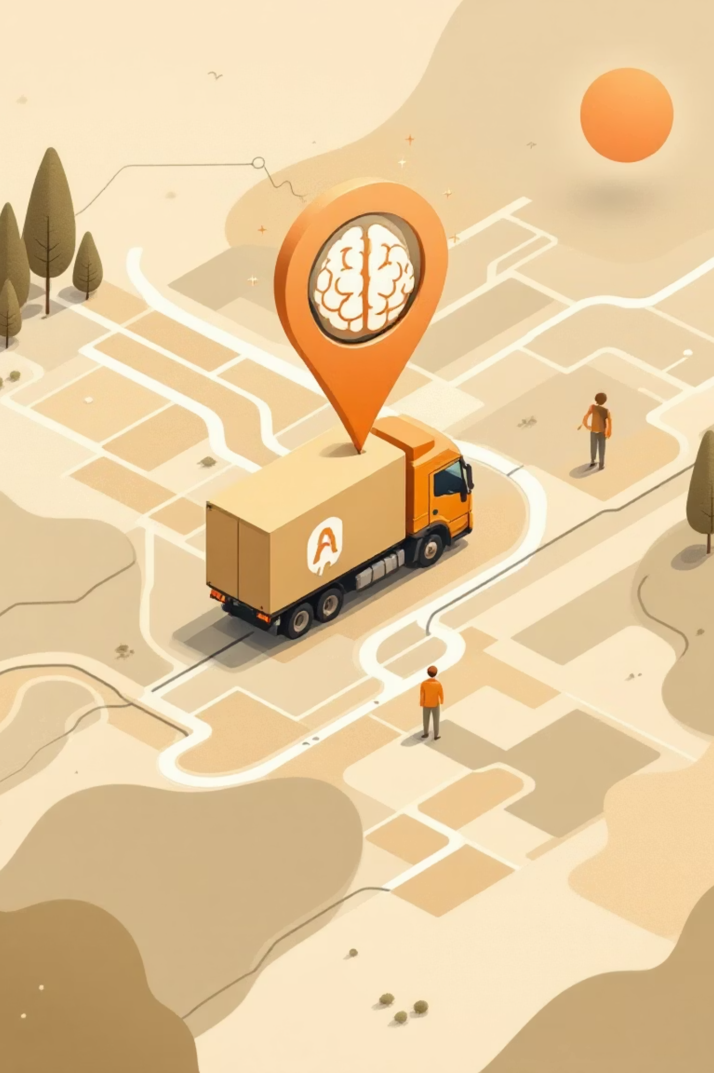
Key Features of TrackMile
1
Live Map Tracking
Leaflet.js updates driver coordinates every 5 seconds on the Admin map.
2
AI Analytics
Generates text-based performance reports for drivers using LLMs.
3
Order Management
Full lifecycle tracking: Created -> Assigned -> Accepted -> Picked Up -> In Transit -> Delivered.
4
Simulated Navigation
Drivers simulate travel through "Checkpoints" for real-time location updates.

Slide 6
Technology Stack
Frontend
React.js
Dynamic user interface for Admin and Driver dashboards.
Backend
Java Spring Boot
REST API architecture for handling logic and security.
Database
MongoDB
NoSQL database for flexible storage of Orders and Drivers.
Mapping
Leaflet.js & OpenStreetMap
Open-source libraries for rendering maps and routes.
AI Engine
Groq API (Llama 3)
Generates natural language summaries of driver performance.

Slide 7

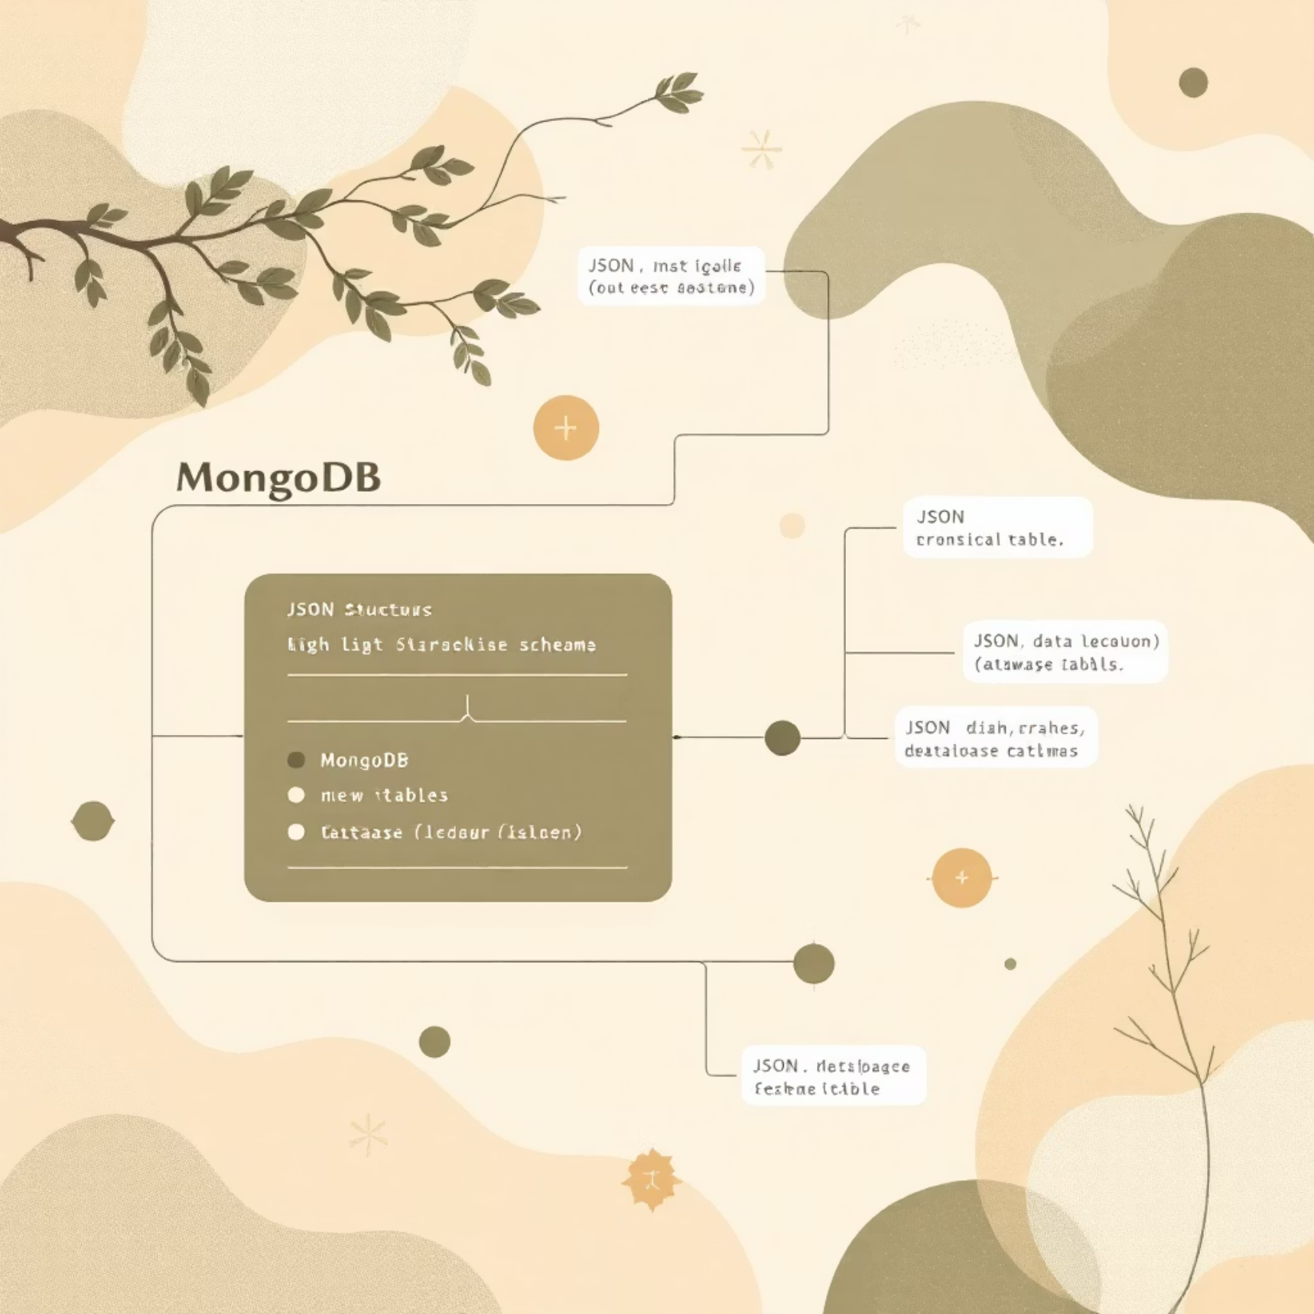
System Architecture & Design
Client-Server Architecture
MongoDB Schema
React.js client sends HTTP requests to Spring Boot backend, which interacts with MongoDB.
Stores three main collections: users, drivers, and orders, with detailed fields for each.

Slide 8

Implementation Details: Live Tracking & AI
01
02
Driver Action
Database Update
Driver clicks "Reach Checkpoint," frontend calculates new coordinates and sends POST request.
Backend updates driver's currentLat and currentLng in MongoDB.
03
04
Admin Polling
Map Refresh
Admin Dashboard polls /api/admin/driver-location every 5 seconds.
React state updates, moving the Leaflet map marker instantly.

Slide 9

AI Performance Reporting
Intelligent Insights with Groq API
The system integrates with Groq API for intelligent insights into driver performance.
Backend fetches all "Delivered" orders for a specific driver.
Prompt is constructed: "Analyze the following delivery data for driver X. Calculate average speed, reliability, and give a performance review."
Llama 3 model returns a paragraph, displayed on the Admin dashboard.

Slide 10


Conclusion & Future Scope
Modernized Logistics
Mobile App
TrackMile successfully combines Spring Boot, React, and AI for holistic delivery management.
Future plan to convert React frontend to React Native for real GPS access.
Route Optimization
Push Notifications
Future implementation of algorithms for shortest path suggestions.
Replacing polling with WebSockets for instant alerts.

Slide 11

Thank You!
We appreciate your time and attention to TrackMile's innovative approach to smart delivery and logistics. We are ready to answer any questions you may have.

